Slide 1



CREATING ASP .NET MVC APPLICATION

Slide 2
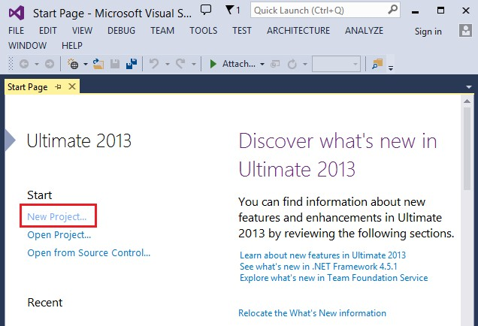
New Project …

Slide 4
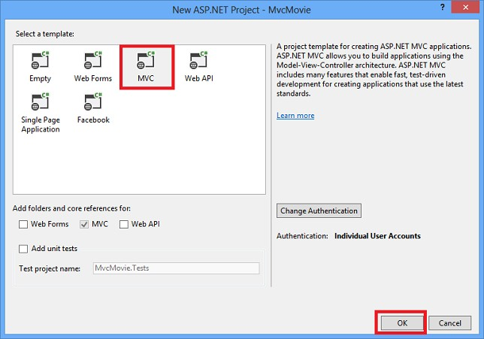
Select the project template

Slide 5
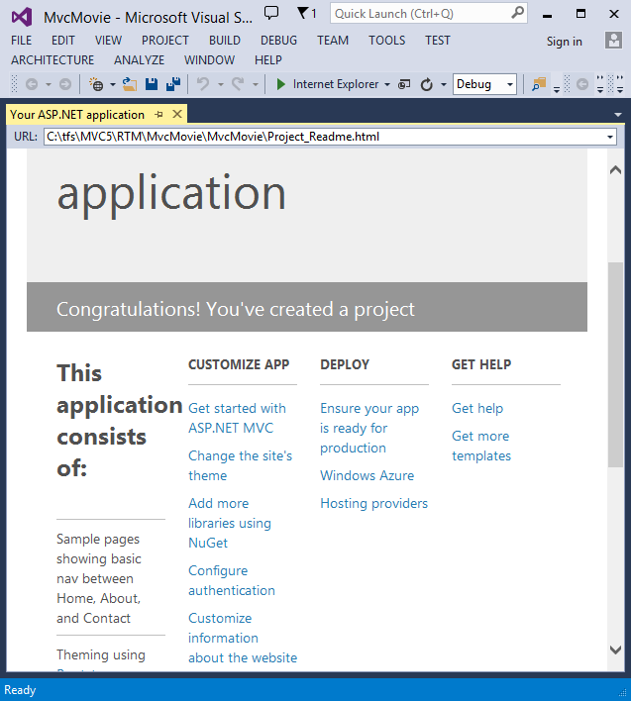
ASP .NET MVC App Home page

Slide 6
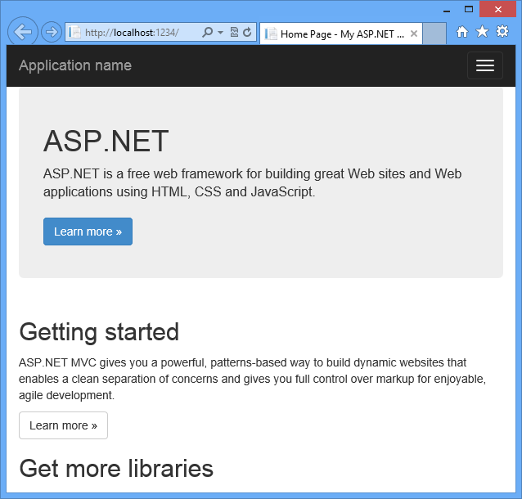
Run the application…

Slide 7
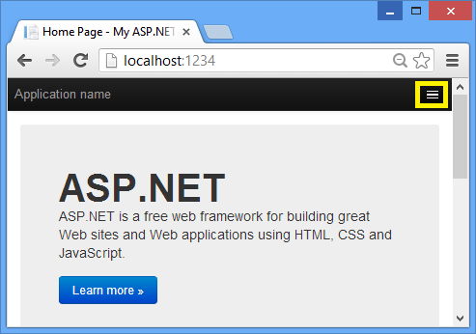
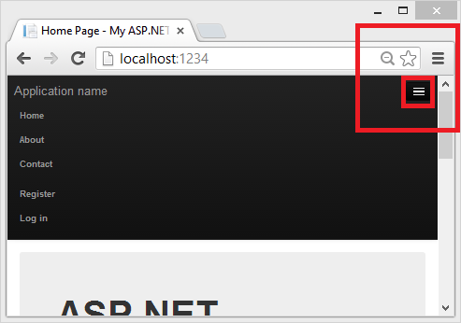
Expand the default App menu

Slide 8
ADDING CONTROLLER

Slide 9
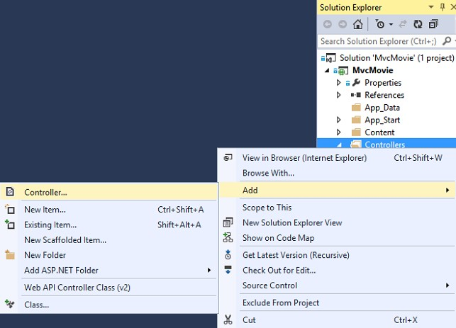
Adding controller

Slide 10
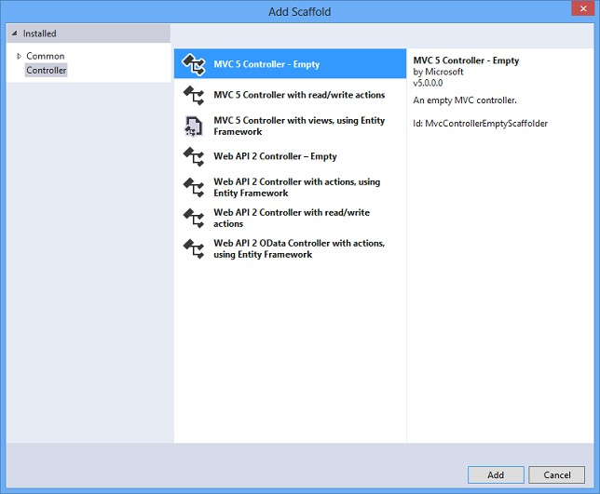
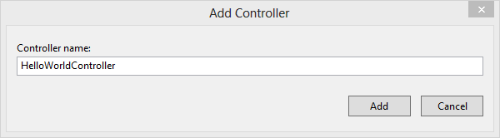
Adding controller (cont.)

Slide 11
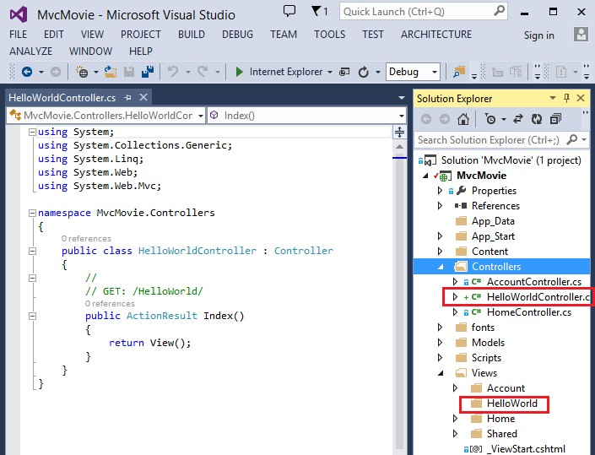
Adding a controller (cont.)

Slide 12
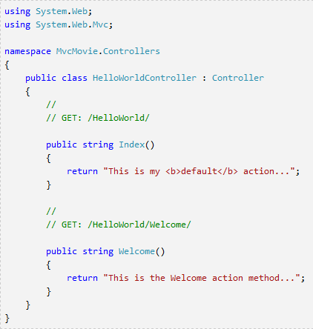
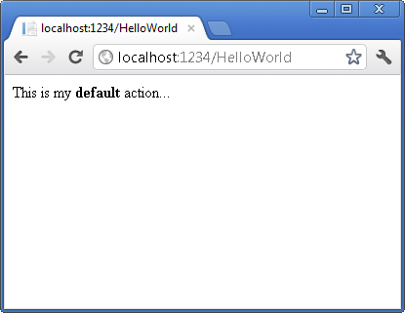
Testing the controller

Slide 13
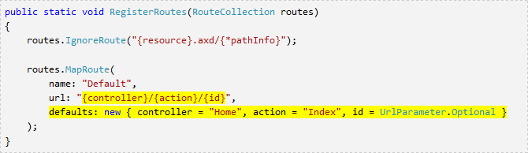
Mapping controller
Controller selection based on URL
Default URL routing logic:
/[Controller]/[ActionName]/[Parameters]
Format for routing in
App_Start/RouteConfig.cs

Slide 14
URL routing
Webapp URL without URL segments => HomeController::Index()
Index() – default method of a controller
/HelloWorld => HelloWorldController
/HelloWorld/Index => HelloWorldController::Index()
http://webapp:port/HelloWorld/Welcome => HelloWorldController::Welcome()

Slide 15

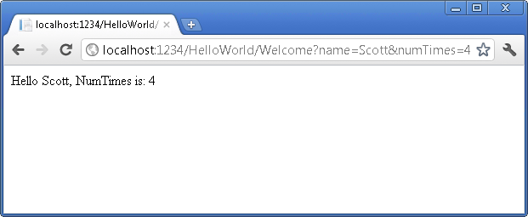
Parameters
/HelloWorld/Welcome?name=Scott&numtimes=4
Introducing 2 parameters to Welcome method
Parameters passed as query strings!

Slide 16

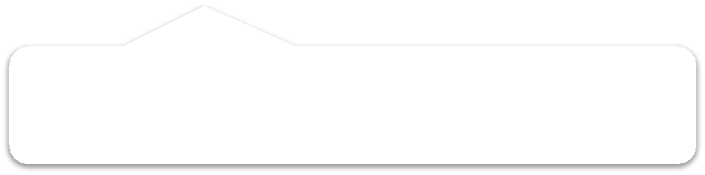
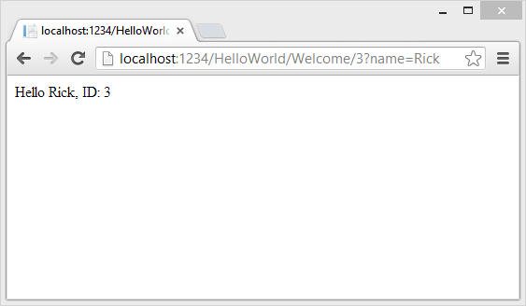


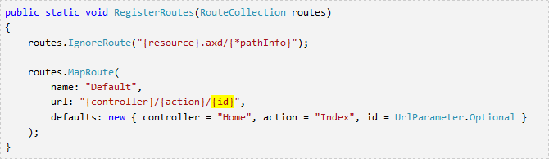
URL Parameters
http://webapp/HelloWorld/Welcome/3?name=Rick
Parameter ID matches URL specification in RegisterRoutes method.

Slide 17
ADDING A VIEW

Slide 18

Views
Views created using Razor view engine
Controller method returns View object
Controller method return type is ActionResult
Common pattern: all view pages share the same master layout page

Slide 19
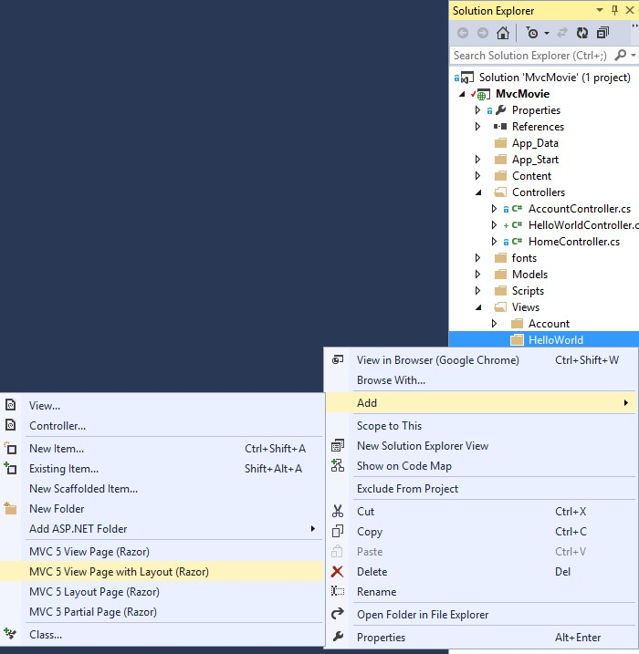
Create View page

Slide 20
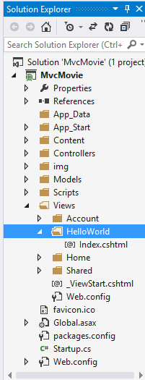
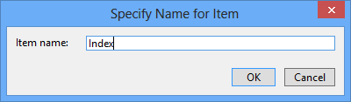
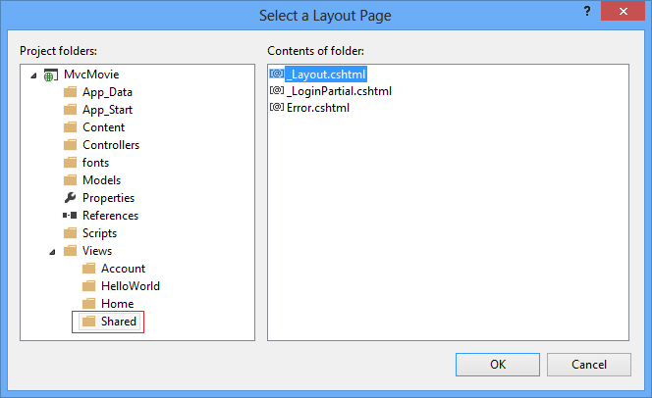





Create View page
Master page.

Slide 21
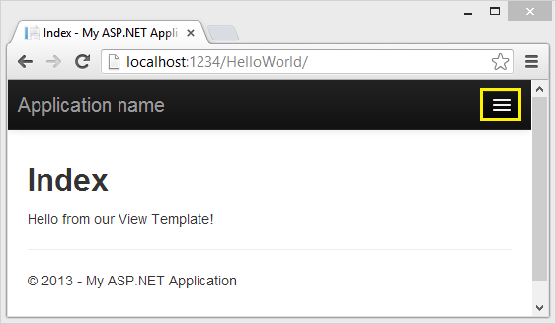






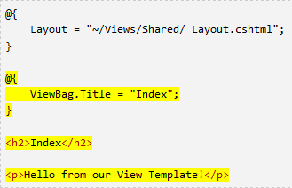




Implementing View page
Selected master page.
Index, by default.
Change controller’s method signature.
The method retures a view object: searches a view file that is named the same as the method (Index.cshtml).

Slide 22



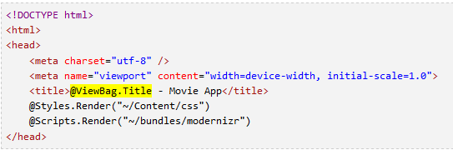



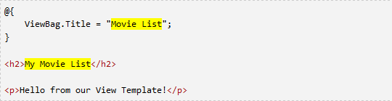
ViewBag
Pass data between view template and layout view file
ViewBag is a dynamic object (has no defined properties)
View template file.
Layout view file.

Slide 23
Passing data from Controller to View
View is used for data presentation
Controller must provide a view with the data
One approach: using ViewBag
Controller puts data to ViewBag,
View reads ViewBag and renders the data
No data binding!
Alternative approach: the view model
Strongly typed approach

Slide 24






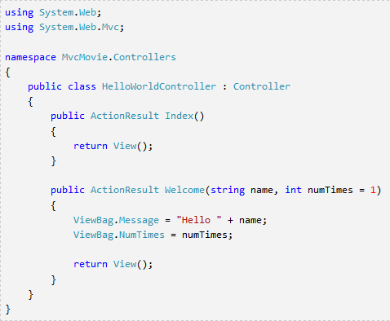
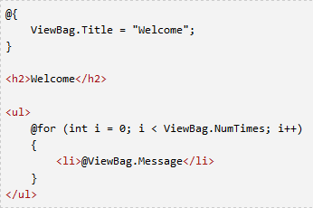
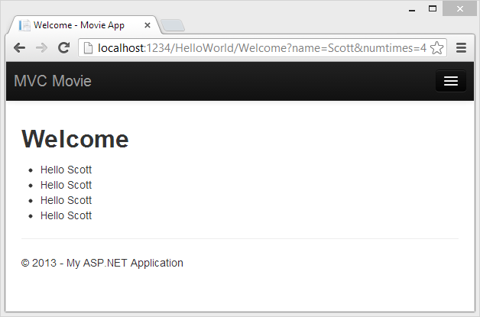



Passing data from Controller to View
Controller
View
Returns HelloWorldView object.

Slide 25
ADDING A MODEL

Slide 26
Model components
Entity framework - data access technology
“Code first” development paradigm
(first code classes, then generate DB schema)
“Database first” development paradigm define db schema first,
then generate models, controllers and views

Slide 27
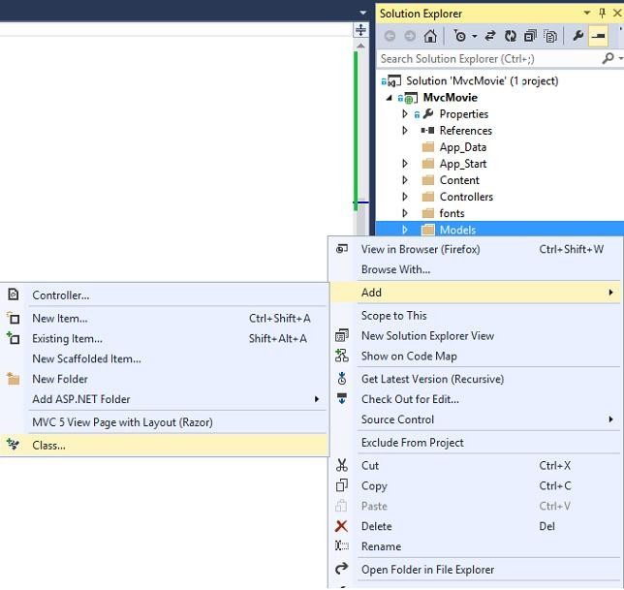



Adding a model class
Enter the class name,
e.g. Movie.cs

Slide 28
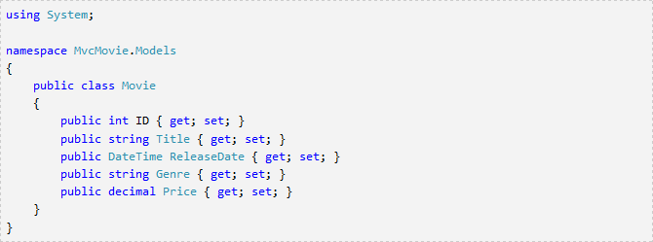
Adding properties to a model class

Slide 29
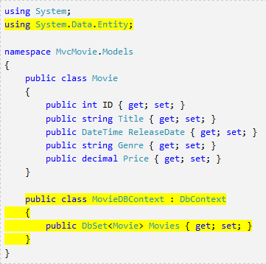






Adding a DbContext class
EF namespace DbContext DbSet
EF database context FETCH, INSERT, UPDATE

Slide 30
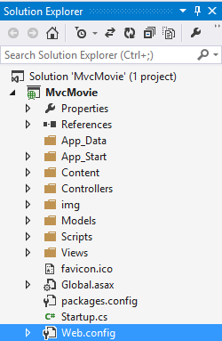
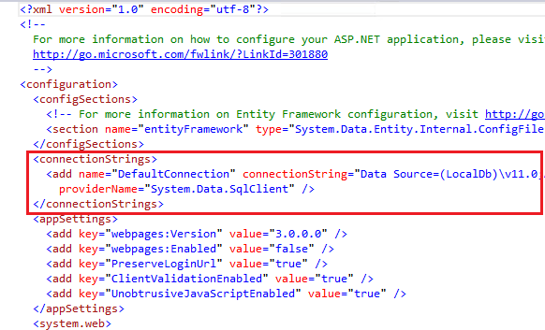



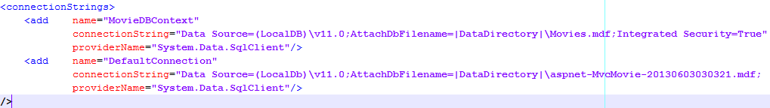
DB Connection string
Separate connection string for each DbContex class

Slide 31
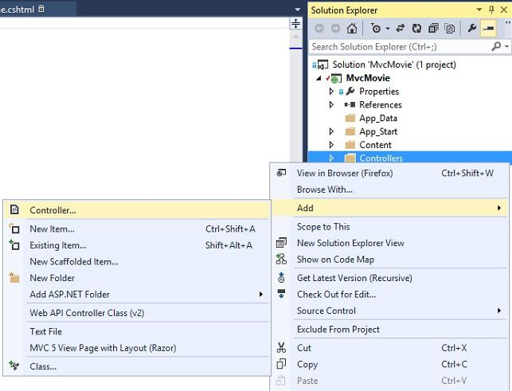
Accessing Model from a Controller

Slide 32
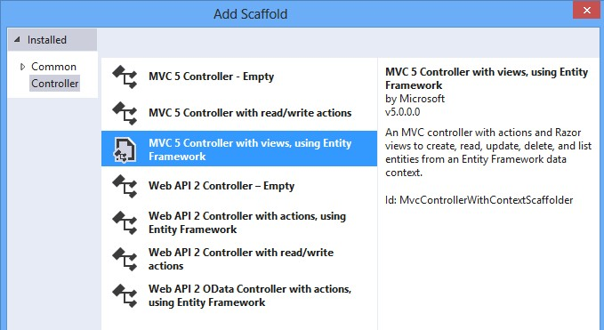
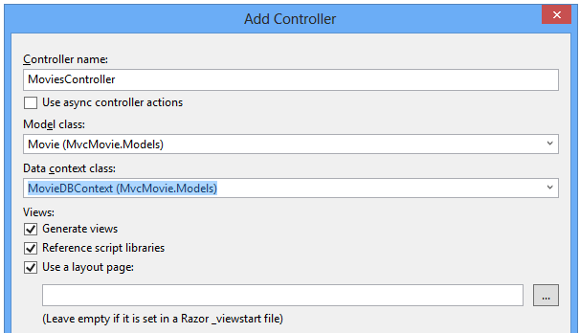
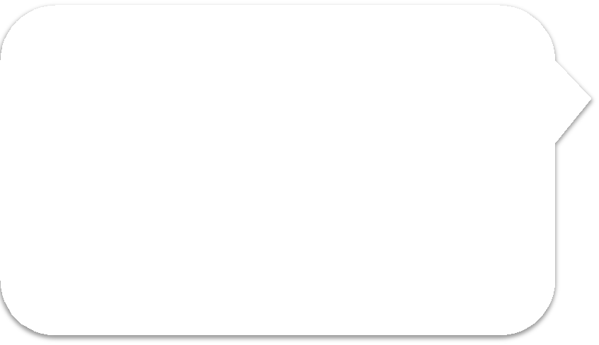




Accessing Model from a Controller
Visual Studio Creates:
A controller MoviesController.cs file in Controllers folder, Create.cshtml, Delete.cshtml, Details.cshtml, Index.cshtml in Views\Movies folder.
Strongly typed
approach.

Slide 33

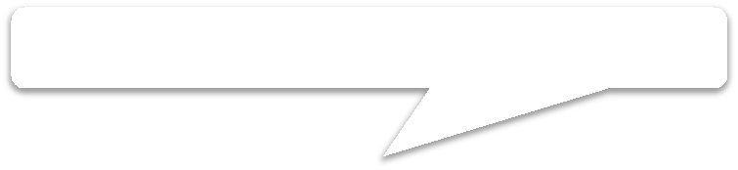

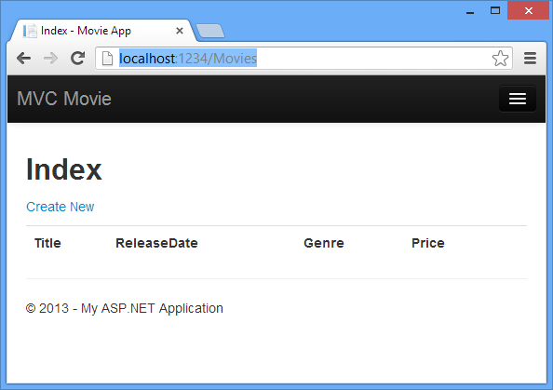







Run Application…
Notice: default routing
Creates a new movie.
Database is still empty.
Notice: generic column name, derived from the model class.

Slide 34
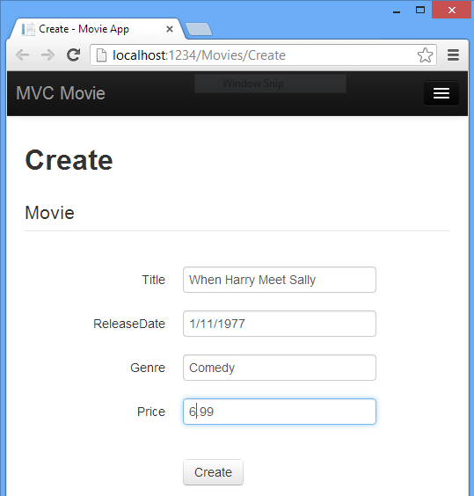



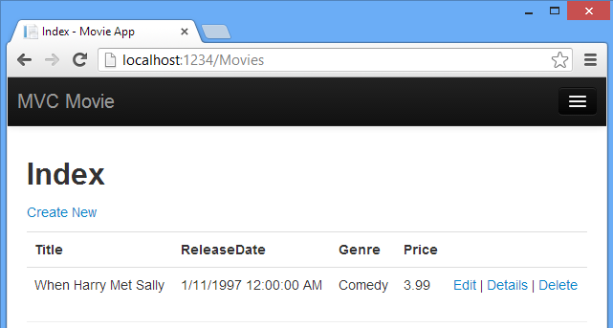


Creating a model object
Automatically generated form, based on the model info.

Slide 35
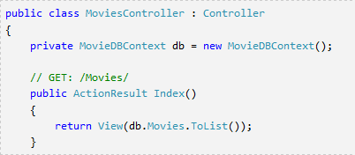






Generated Controller class
Instantiated DbContext instance.
Index method.

Slide 36
Strongly typed models
MVC provides strongly typed way of passing data from Controller to View
Better compile-time checking
Richer IntelliSense in VS code editor

Slide 37


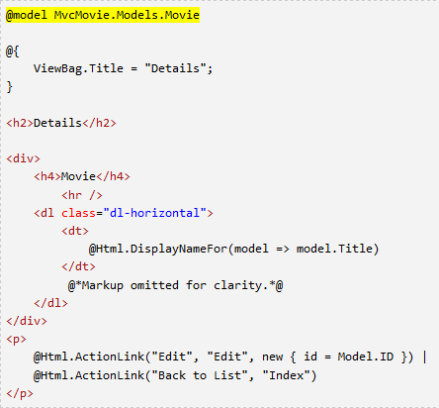




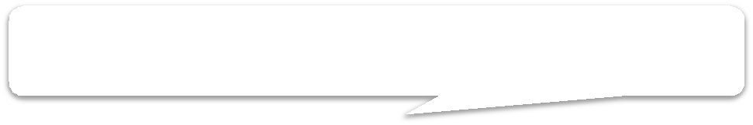



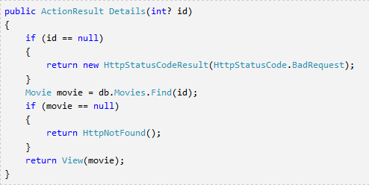

Strongly typed models
@model: Specifies class of the model
Communicates with the master page.
Id parameter generally passed as a part of the route.
Context-sensitive
data access.

Slide 38






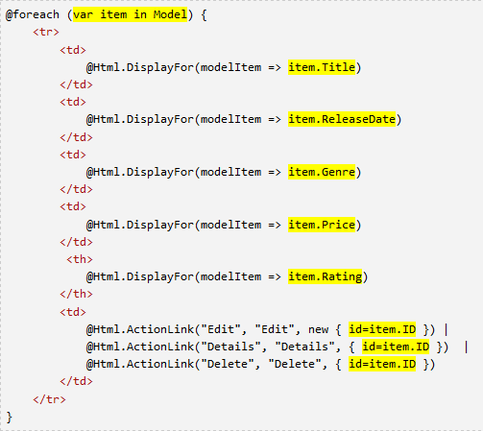



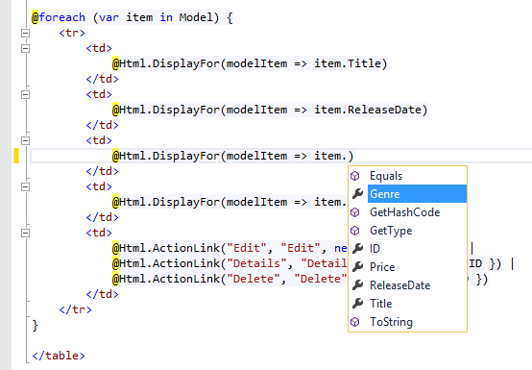
Strongly typed models (cont.)
Index.cshtml
Model object is strongly typed.
Each item is a Movie object.
Full compile-time support.

Slide 39
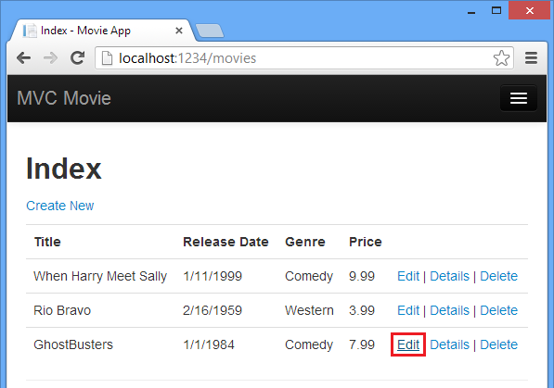






Edit View
Localhost:1234/movies/Edit/4
URL generated using Html Helpers!

Slide 40
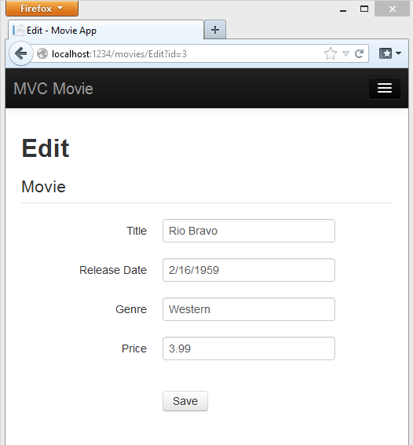









Edit View (cont.)
Parameter passed through the URL query.
Works for MVC default URL mapping.
Label defined in the model class.
Date format defined in the model class.

Slide 41












Edit View
Generates hidden anti-forgery token.
Generates html label.
Generates text box.
Generates validation message.

Slide 42







Property annotations
Annotations namespace.
Overrides default label name on the view page.
Specifies type of the data: displays only date part.
Workaround for a bug in Chrome
☺

Slide 43







ActionLink helper
Html.ActionLink – generates a link according to
a given URL mapping policy
Primer:
Anonymous object – specifies ID of an object
Html.ActionLink(“Edit", “Edit", new{id=item.ID)}
Controller action name.

Slide 44















Edit actions
Implemented as Controller’s operations
HTTP GET operation HTTP POST operation
Prevents request forgery
[Bind] attribute – a security mechanism that prevents over-posting data to the model.
[HttpGet] annotation by default.

Slide 45














Processing the POST request
HTTP POST method. Validates the forgery token.
Checks if sent data are valid – server side validation, compared to client-side validation (javascript)
Redirects after successful update.
In case of invalid data, the original form is returned
back to the client, displaying error messages

Slide 46
HTTP methods – best practices
HttpGet and HttpPost method overloads
All methods that modify data SHOULD use HttpPost method overload
Modifying data in HttpGet method
security risk
Violates HTTP best practices
Violates REST architectural pattern
GET method SHOULD NOT have any side effect and SHOULD NOT modify persistent data

